Slide 1
Microsoft Word 2010
Chapter 1
Creating, Formatting, and Editing a Word Document with Pictures

Slide 2
Objectives
Enter text in a Word document
Check spelling as you type
Format paragraphs
Format text
Undo and redo commands or actions
Change theme colors

Slide 3
Objectives
Insert digital pictures in a Word document
Format pictures
Add a page border
Correct errors and revise a document
Change document properties
Print a document

Slide 4
Project – Flyer with Pictures

Slide 5
General Project Guidelines
Choose the words for the text
Identify how to format various elements of the text
Find the appropriate graphical images(s)
Establish where to position and how to format the graphical image(s)
Determine whether the page needs enhancements such as border or spacing adjustments
Correct errors and revise the document as necessary
Determine the best method for distributing the document

Slide 6
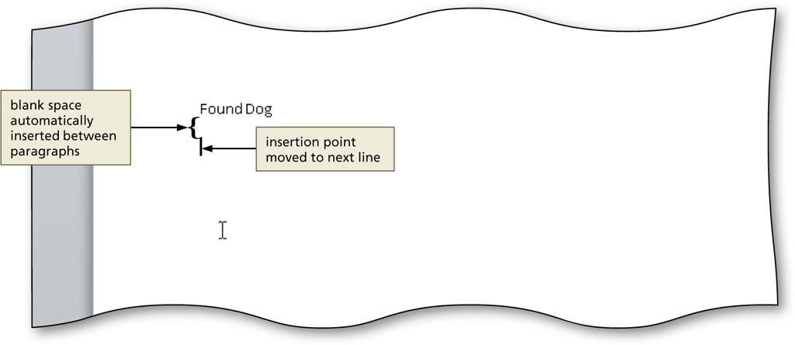
Entering Text
Type the text in the Word document
To move the insertion point to the beginning of the next line, press the ENTER key

Slide 7
Displaying Formatting Marks
If the Home tab is not the active tab, click Home on the Ribbon to display the Home tab.
If it is not selected already, click the Show/Hide ¶ button (Home tab | Paragraph group) to display formatting marks on the screen

Slide 8
Displaying Formatting Marks

Slide 9
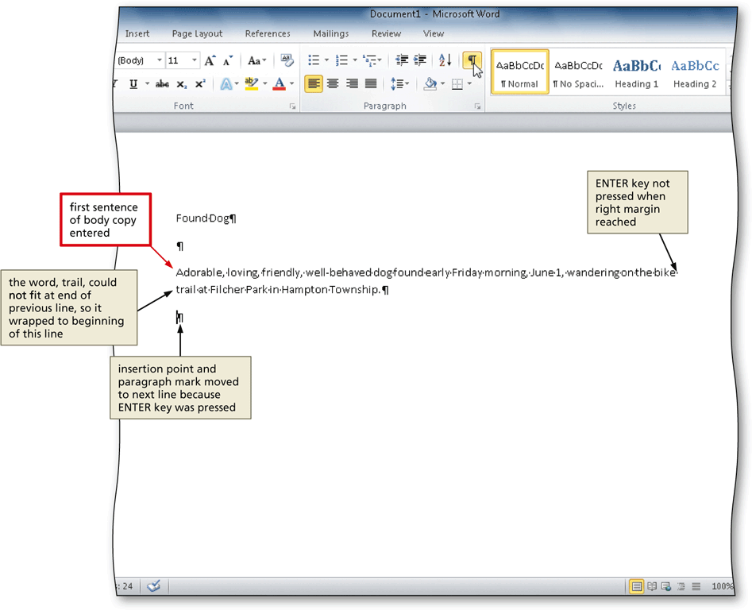
Wordwrap
Wordwrap allows you to type words in a paragraph continually without pressing the ENTER key at the end of each line

Slide 10
Checking Spelling and Grammar as You Type
Type the misspelled text and then press the SPACEBAR so that a red wavy line appears below the misspelled word
Right-click the flagged word to display a shortcut menu that presents a list of suggested spelling corrections for the flagged word
Click the correct word on the shortcut menu

Slide 11
Checking Spelling and Grammar as You Type

Slide 12
Navigating a Document

Slide 13
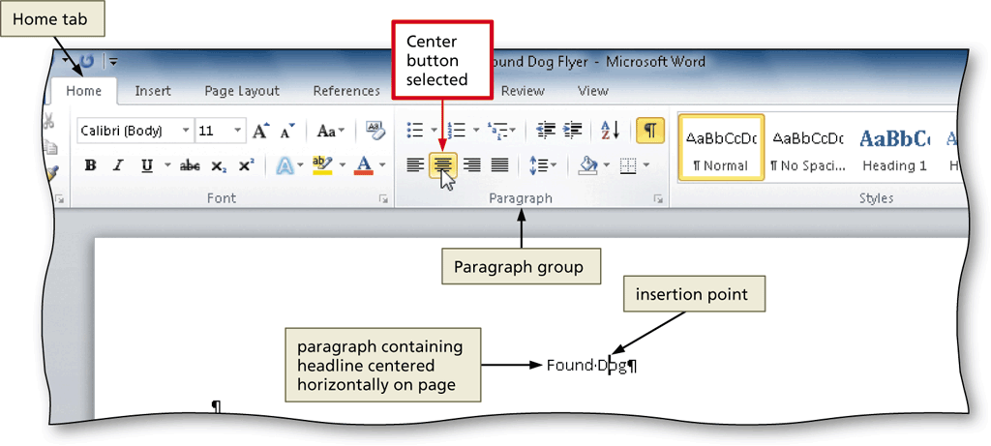
Centering a Paragraph
Click somewhere in the paragraph to be centered to position the insertion point in the paragraph to be formatted
Click the Center button (Home tab | Paragraph group) to center the paragraph containing the insertion point

Slide 14
Selecting a Line
Move the mouse pointer to the left of the line to be selected until the mouse pointer changes to a right-pointing block arrow
Click the mouse to select the entire line to the right of the mouse pointer

Slide 15
Changing the Font Size of Selected Text
With the text selected, click the Font Size box arrow (Home tab | Font group) to display the Font Size gallery
Point to the desired point size in the Font Size gallery to display a live preview of the selected text at the selected point size
Click the desired point size to change the font size of the selected text

Slide 16
Changing the Font Size of Selected Text

Slide 17
Changing the Font of Selected Text
With the text selected, click the Font box arrow (Home tab | Font group) to display the Font gallery
Scroll through the Font gallery, and then point to the desired font to display a live preview of the selected text in the selected font
Click the font to change the font of the selected text

Slide 18
Changing the Font of Selected Text

Slide 19
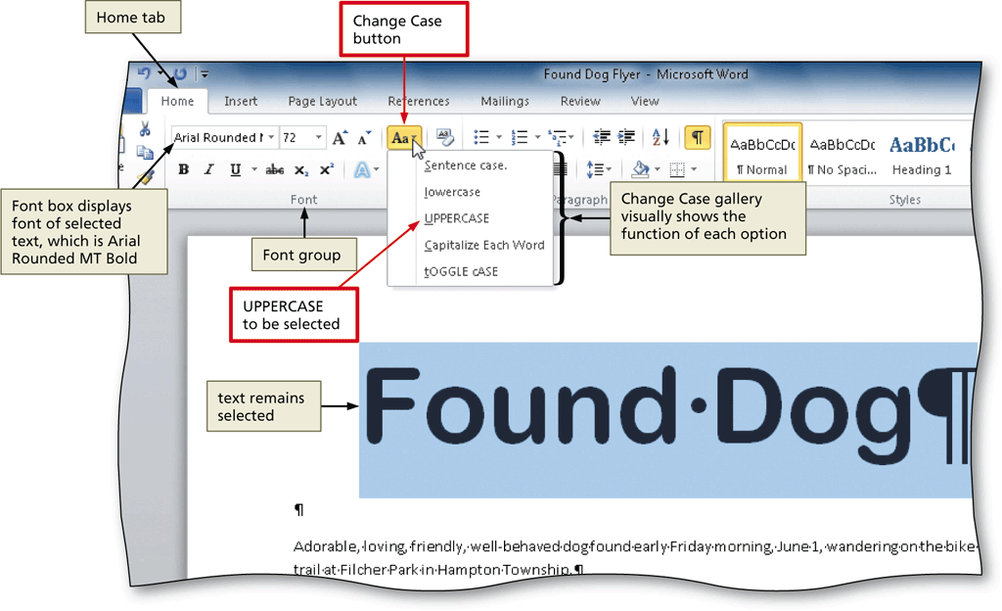
Changing the Case of Selected Text
With the text selected, click the Change Case button (Home tab | Font group) to display the Change Case gallery
Click the desired case in the Change Case gallery to change the case of the selected text

Slide 20
Applying a Text Effect to Selected Text
With the text selected, click the Text Effects button (Home tab | Font group) to display the Text Effects gallery
Point to the desired text effect to display a live preview of the selected text in the selected text effect
Click the text effect to change the text effect of the selected text

Slide 21
Applying a Text Effect to Selected Text

Slide 22
Shading a Paragraph
Click somewhere in the paragraph to be shaded
Click the Shading button arrow (Home tab | Paragraph group) to display the Shading gallery
Point to the desired shading to display a live preview of the selected shading color
Click the shading color

Slide 23
Shading a Paragraph

Slide 24
Selecting Multiple Lines
Move the mouse pointer to the left of the first paragraph to be selected until the mouse pointer changes to a right-pointing block arrow
Drag downward to select all lines that will be formatted

Slide 25
Bulleting a List of Paragraphs
Move the mouse pointer to the left of the first paragraph to be selected until the mouse pointer changes to a right-pointing block arrow
Drag downward until all paragraphs that will be formatted with a bullet character are selected
Click the Bullets button (Home tab | Paragraph group) to place a bullet character at the beginning of each selected paragraph

Slide 26
Bulleting a List of Paragraphs

Slide 27
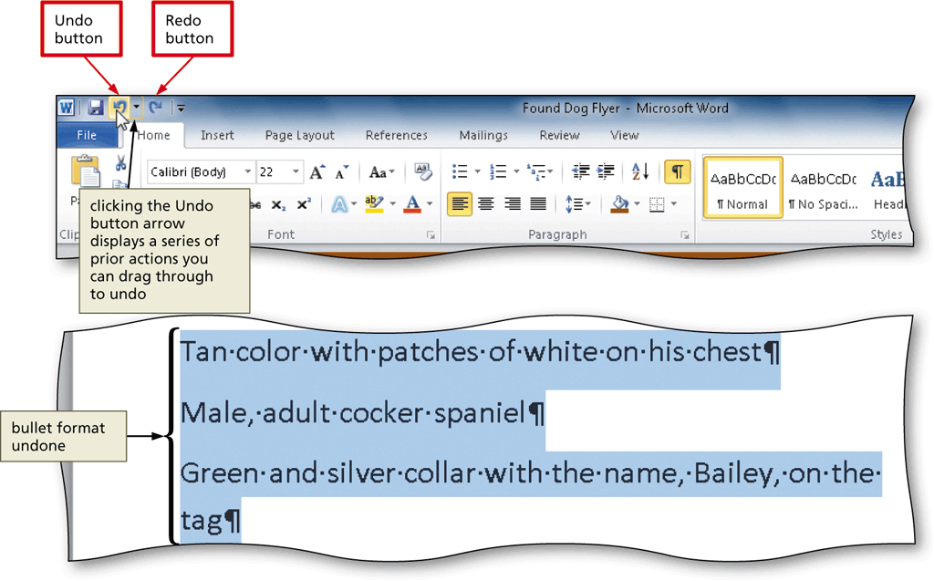
Undoing and Redoing an Action
Click the Undo button on the Quick Access Toolbar to reverse your most recent action
Click the Redo button on the Quick Access Toolbar to reverse your most recent undo

Slide 28
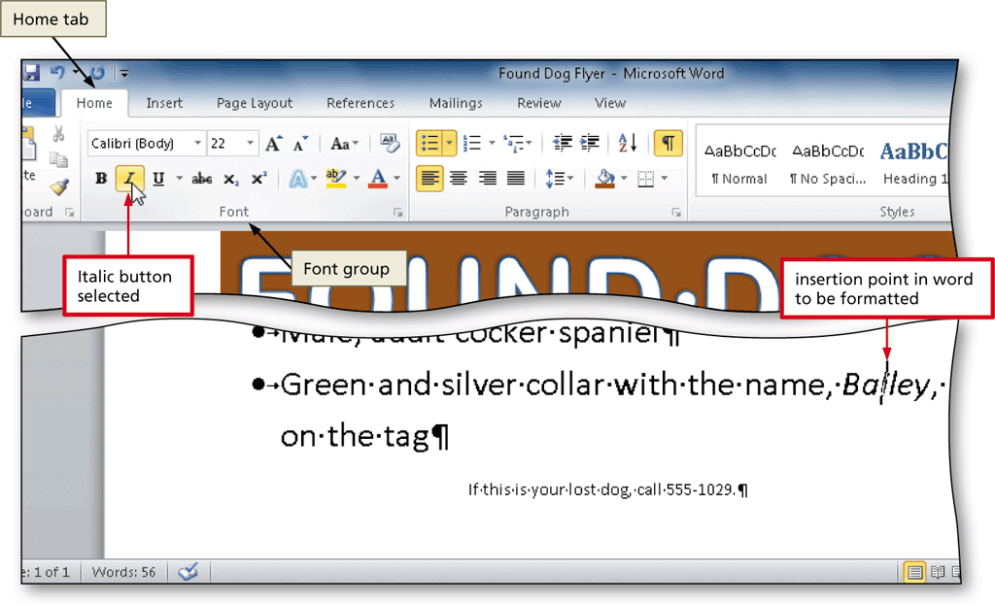
Italicizing Text
Click somewhere in the word to be italicized to position the insertion point in the word to be formatted
Click the Italic button (Home tab | Font group) to italicize the word containing the insertion point

Slide 29
Coloring Text
With the insertion point in the word to format, click the Font Color button arrow (Home tab | Font group) to display the Font Color gallery
Point to the desired font color to display a live preview of the desired font color
Click the font color to change the color of the text

Slide 30
Coloring Text

Slide 31
Using the Mini Toolbar to Format Text
Select the text to format, and then move the mouse pointer into the transparent Mini toolbar, so that it changes to a bright toolbar

Slide 32
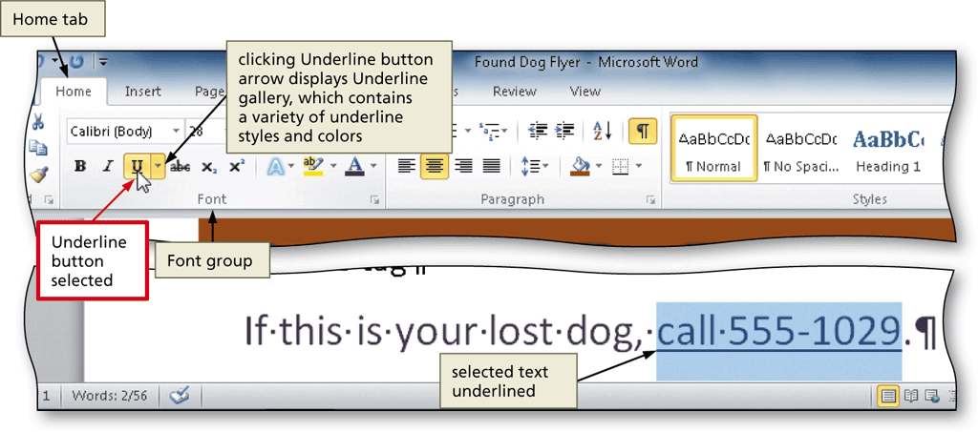
Underlining Text
With the text selected, click the Underline button (Home tab | Font group) to underline the selected text

Slide 33
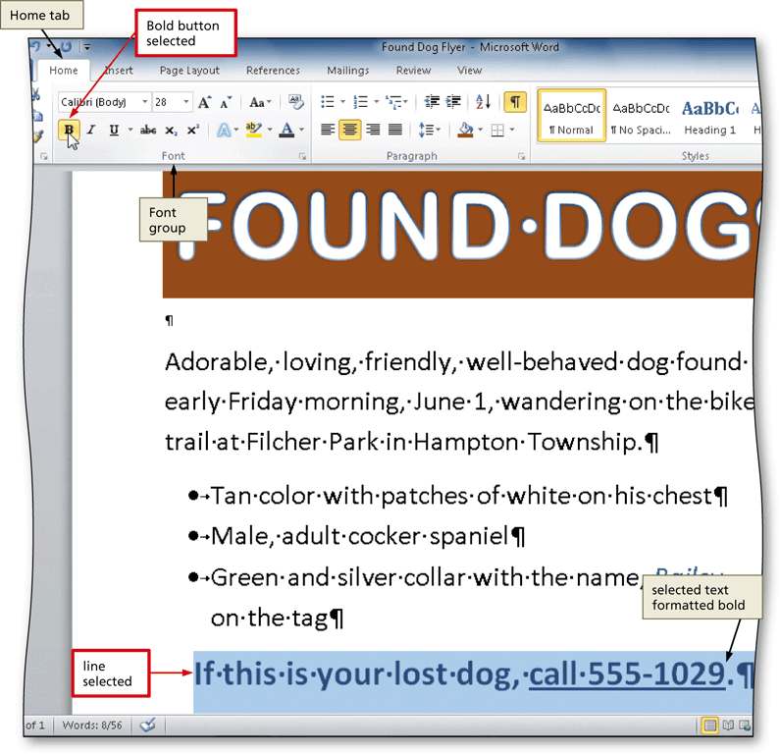
Bolding Text
With the text selected, click the Bold button (Home tab | Font group) to bold the selected text

Slide 34
Changing Theme Colors
Click the Change Styles button (Home tab | Styles group) to display the Change Styles menu
Point to Colors on the Change Styles menu to display the Colors gallery
Click the desired theme color to change the document theme colors

Slide 35
Changing Theme Colors

Slide 36
Inserting a Picture
Position the insertion point where you want to insert the picture
Click Insert on the Ribbon to display the Insert tab
Navigate to the picture location
Select the picture you wish to insert
Click the Insert button (Insert Picture dialog box) to insert the picture at the location of the insertion point in the document

Slide 37
Inserting a Picture

Slide 38
Zooming the Document
Click the Zoom Out or Zoom In button as many times as necessary

Slide 39
Resizing a Graphic
Drag one of the sizing handles to increase or decrease the size of the graphic

Slide 40
Resizing a Graphic by Entering Exact Measurements
With the graphic selected, click the Shape Height box (Picture Tools Format tab | Size group) to select the contents in the box and then type the desired height
Click the Shape Width box to select the contents in the box, type the desired width, and then click the picture to apply the settings

Slide 41
Resizing a Graphic by Entering Exact Measurements

Slide 42
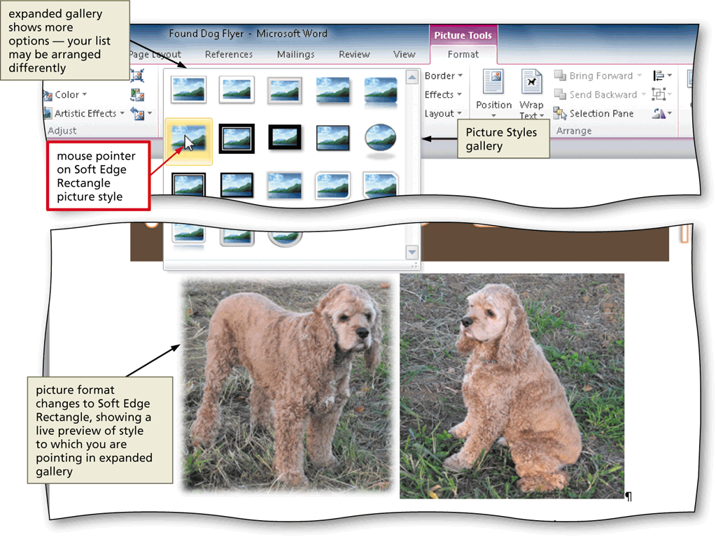
Applying a Picture Style
With the picture selected, click the desired picture style in the Picture Styles gallery (Picture Tools Format tab | Picture Styles group). Click the More button to display additional picture styles

Slide 43
Applying Picture Effects
Click the Picture Effects button (Picture Tools Format tab | Picture Styles group) to display the Picture Effects menu
Point to the desired picture effect type
Click the desired picture effect in the gallery to apply the selected picture effect

Slide 44
Applying Picture Effects

Slide 45
Viewing One Page
Click View on the Ribbon to display the View tab
Click the One Page button (View tab | Zoom group) to display the entire page in the document window as large as possible

Slide 46
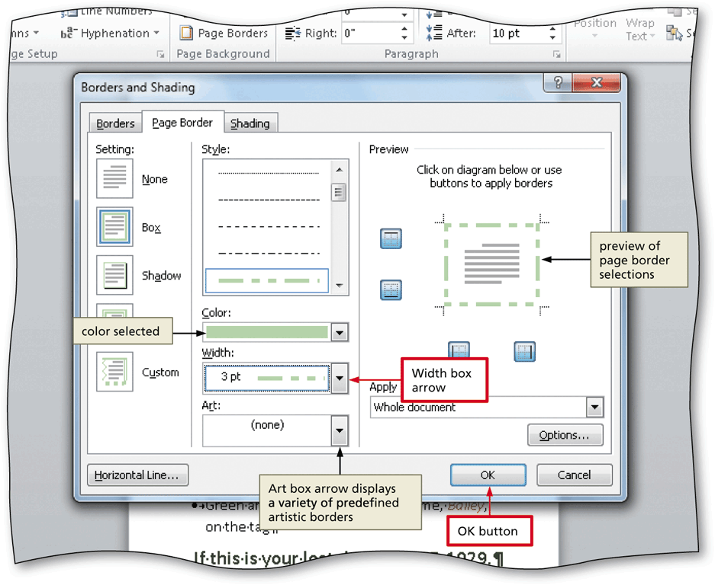
Adding a Page Border
Click Page Layout on the Ribbon to display the Page Layout tab
Click the Page Borders button (Page Layout tab | Page Background group) to display the Borders and Shading dialog box

Slide 47
Changing Spacing Before and After a Paragraph
Click Page Layout on the Ribbon to display the Page Layout tab
Position the insertion point in the paragraph to be adjusted
Change the values in the Spacing Before and Spacing After boxes

Slide 48
Changing Spacing Before and After a Paragraph

Slide 49
Deleting Text
Select the text to be deleted
With the text selected, press the DELETE key to delete the selected text

Slide 50
Moving Text
Select the text to be moved
With the mouse pointer in the selected text, press and hold down the mouse button, which displays a dotted insertion point and a small dotted box with the mouse pointer
Drag the dotted insertion point to the location where the selected text is to be moved
Release the mouse button to move the selected text to the location of the dotted insertion point

Slide 51
Moving Text

Slide 52
Changing Document Properties
Click File on the Ribbon to open the Backstage view
If necessary, click the Info tab to display the Info gallery
Click the Properties button in the right pane of the Info gallery to display the Properties menu
Click Show Document Panel on the Properties menu to close the Backstage view and display the Document Information Panel in the Word document window

Slide 53
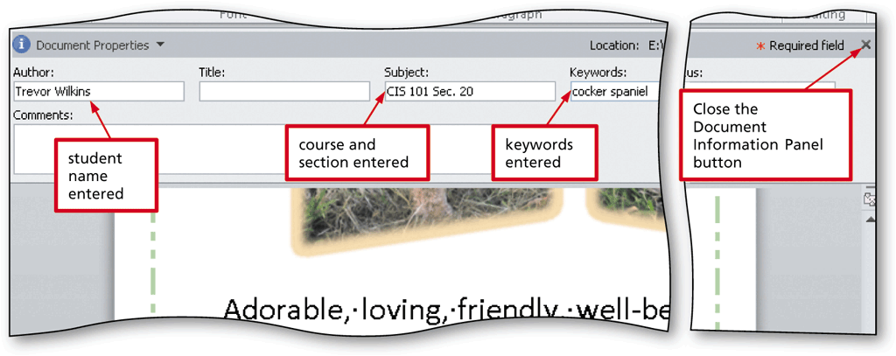
Changing Document Properties
Type the properties in the respective text boxes
Click the Close the Document Information Panel button so that the Document Information Panel no longer is displayed

Slide 54
Printing a Document
Click File on the Ribbon to open the Backstage view
Click the Print tab in the Backstage view to display the Print gallery
Verify the printer name that appears on the Printer Status button will print a hard copy of the document. If necessary, click the Printer Status button to display a list of available printer options and then click the desired printer to change the currently selected printer

Slide 55
Printing a Document

Slide 56
Chapter Summary
Enter text in a Word document
Check spelling as you type
Format paragraphs
Format text
Undo and redo commands or actions
Change theme colors

Slide 57
Chapter Summary
Insert digital pictures in a Word document
Format pictures
Add a page border
Correct errors and revise a document
Change document properties
Print a document

Slide 58
Microsoft Word 2010
Chapter 1 Complete

