Slide 1
BASIC MARKETING
“I can identify and understand the basic concepts and the core standards of marketing”

Slide 2
What is
SPORTS & ENTERTAINMENT MARKETING?
Let’s break it up…
MARKETING:
The process of developing, pricing, promoting, and distributing products, or goods and services to satisfy customers’ needs and wants
SPORTS:
A source of diversion or physical activity engaged in for pleasure
SPECTATOR OR PARTICIPANT
ENTERTAINMENT:
Whatever people are willing to spend their money and spare time viewing rather than participating

Slide 3
It is the goal of the sports and entertainment marketer to provide a product or service that can satisfy the needs and wants of those individuals who choose to be entertained during their leisure time
=
SPORTS
MARKETING

Slide 4
Who are we marketing to??
MARKET:
All people who share similar needs and wants and who have the ABILITY and WILLINGNESS to purchase a given product or service
TARGET MARKET:
The group of people most likely to become customers, identified for a specific marketing program

Slide 5
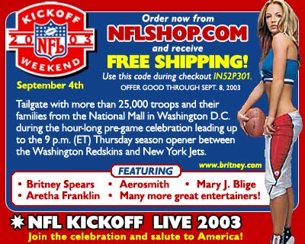
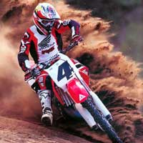



PRODUCERS
Individuals or Companies which have products to be sold.
They provide the “supply.”
They are willing to exchange the product or service for something of value.
Notes:
3

Slide 6
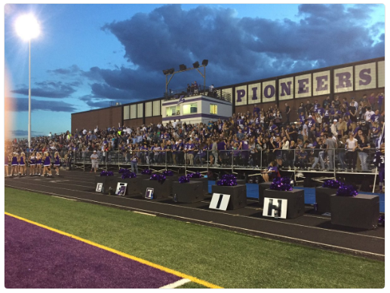
CONSUMERS
Individuals or Companies which have needs to be met and which have something to exchange.
They create a “Demand.”
They have something to exchange for a product or service and are willing to do so.
Notes:
4

Slide 7
PRODUCTS
Good or Service
Goods are Tangible
  Example: Football, Jersey, or Hammer
Services are In-tangible
  Example: Game, Transportation, or Hair cut

Slide 8
EXCHANGES
Everyday transactions between producers and consumers
Typically trading money for a product or service
Notes:
2

Slide 9
Businesses must satisfy customers’ needs and wants in order to make a profit
THE MARKETING CONCEPT
=

Slide 10
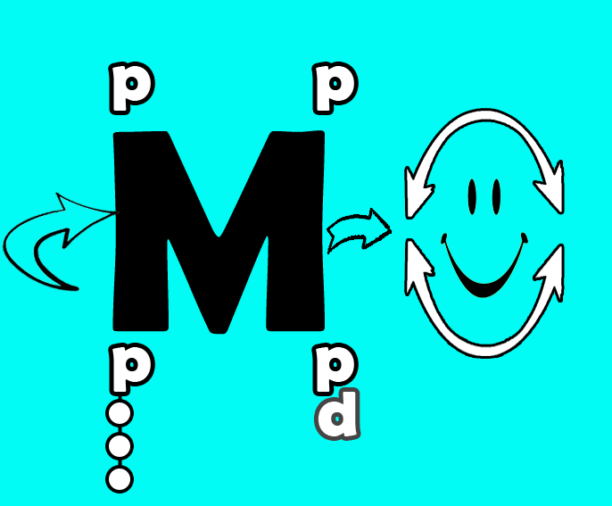
MARKETING MIX –
THE FOUNDATION OF MARKETING

Slide 11
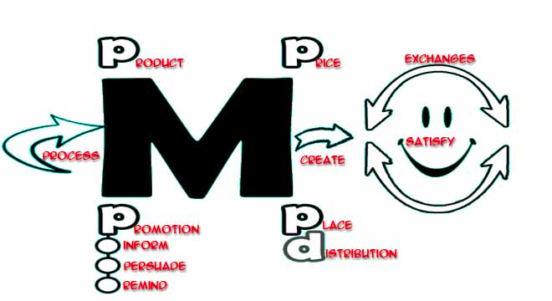

Slide 12




MARKETING MIX
Basic marketing strategies – the four P’s
  Product
  Place
  Price
  Promotion

Slide 13
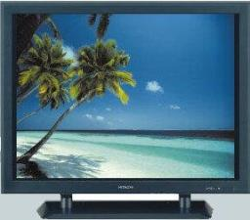



Product Strategies
What product to make
How to package it
What brand name to use
What image to project

Slide 14


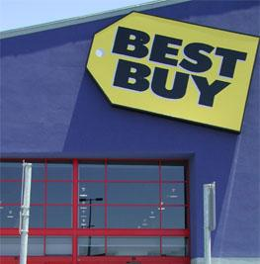



Place Strategies
How and where a product will be distributed.

Slide 15
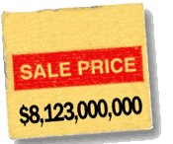
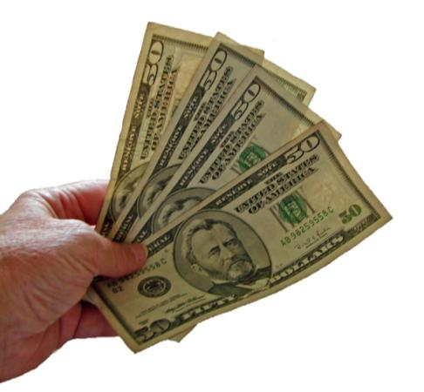

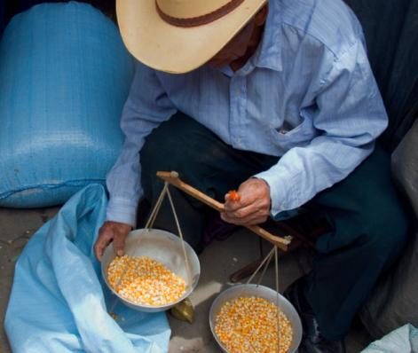
Price Strategies
Reflect what customers are willing and able to pay.

Slide 16

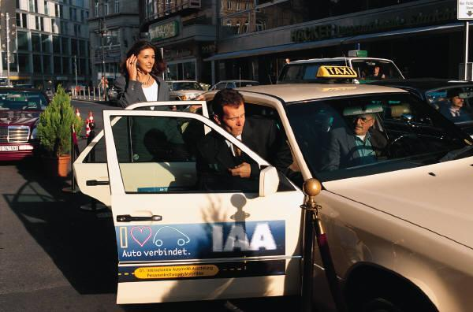
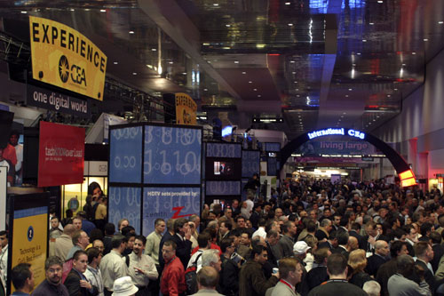
Promotion Strategies
How potential customers will be told about the new product
What the message will be
When and where it will be delivered
What inducements are there to purchase it
INFORM
PERSUADE
REMIND

Slide 17
The Marketing Mix
The elements are INTERCONNECTED
Product
Place
Price
Promotion

Slide 18
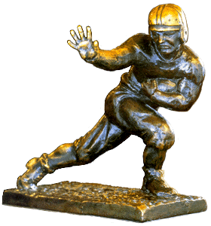





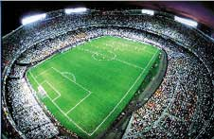
MARKETING OF SPORTS
Applying marketing Principles to the marketing of a “Sports Property”
Sports Properties:
  League 5) Team
  Athlete 6) Stadium 9) Arena
  Program 7) Event 10) Meet
  Competition 8) Contest
Notes:
10. 11

Slide 19
“PLAYAS” IN MARKETING OF SPORTS
Teams
Leagues
Venues
Athletes
Agents
WHAT IS THEIR JOB?
Notes:
Agents #21

Slide 20

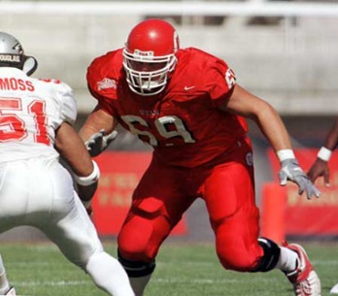




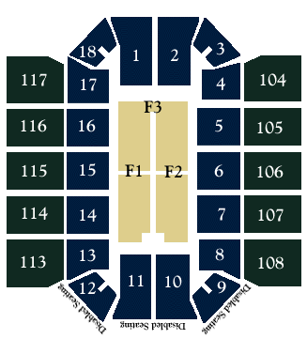

MARKETING OF SPORTS
Examples:

Slide 21







Marketing THROUGH Sports
Marketing of Non-Sports products or services using sports as a media
Using a team or event for marketing
Notes:
12

