Slide 1
Sponsorship

Slide 2
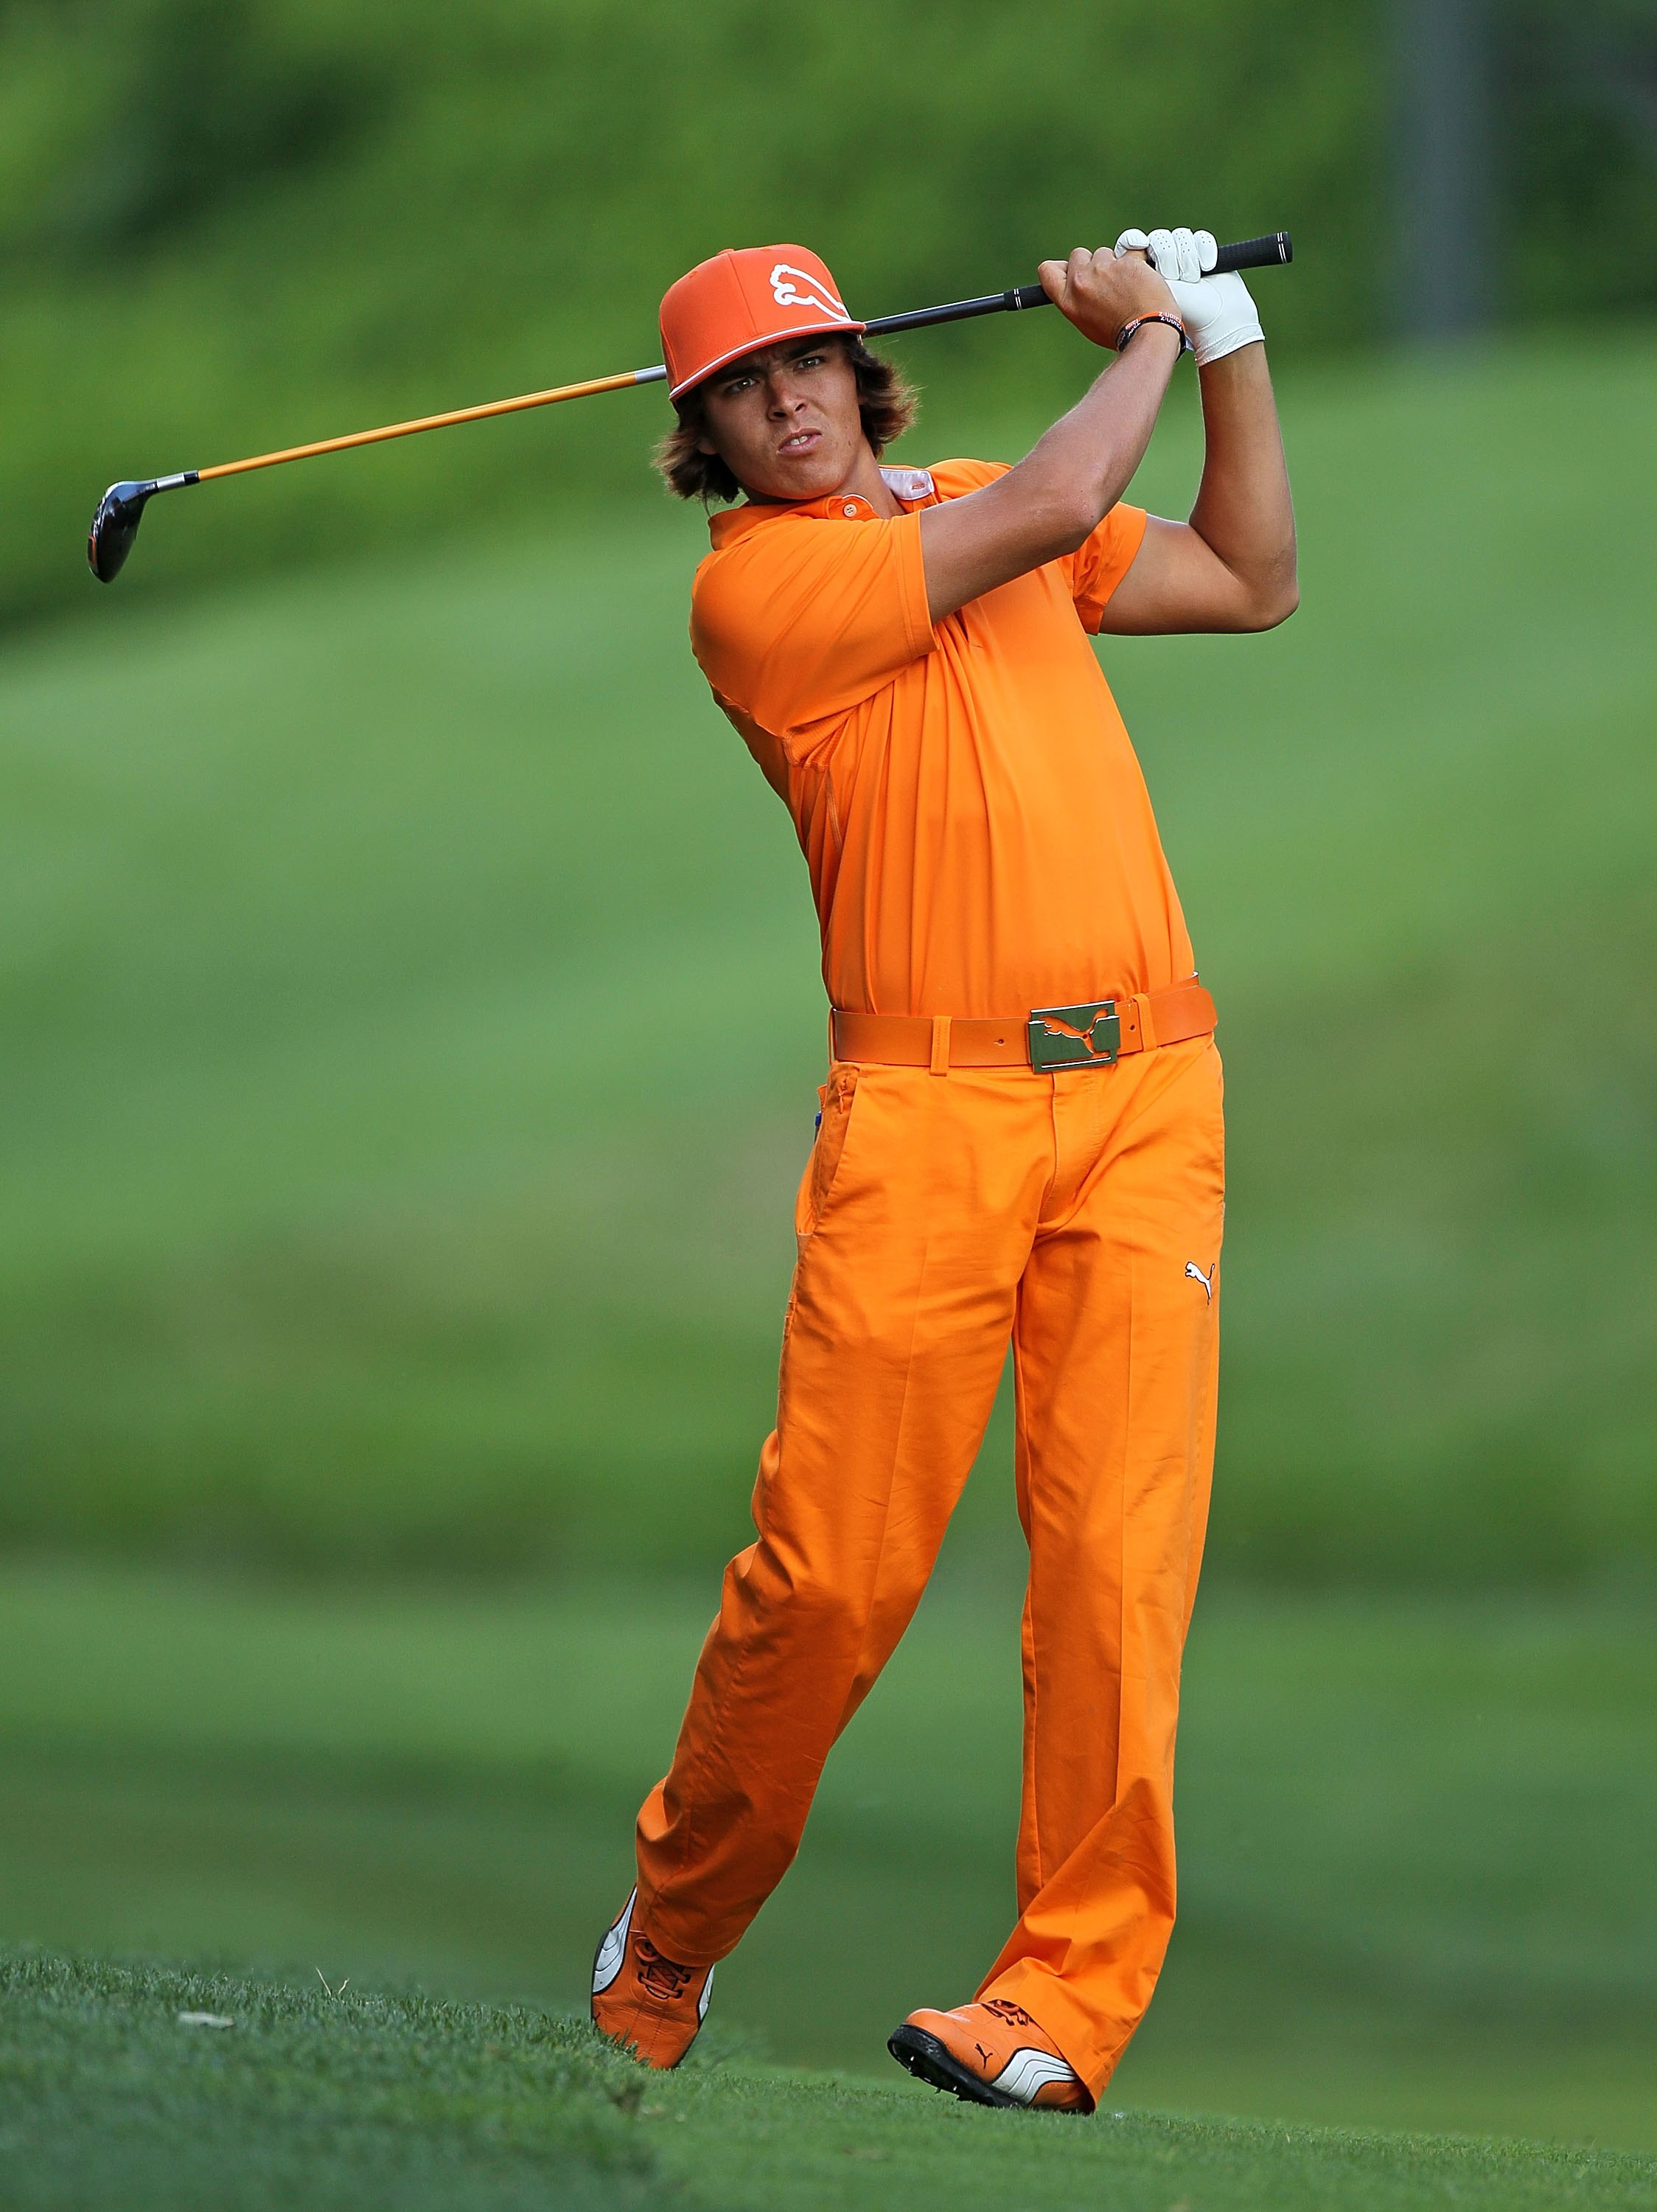
Sponsorship
DEFINED:
Investment in a sports entity or property to achieve organizational goals
Examples
Wayne’s World
Visa Halftime Show
Red Bull Space Jump

Slide 3
Goals of Sponsorship
Goals are:
Direct – easily measured
“tangible”
What can be measured?
Indirect – not easily measured
“intangible”
What can be “felt” but not measured?
Notes:
https://www.youtube.com/watch?v=PM2NocuEihw

Slide 4
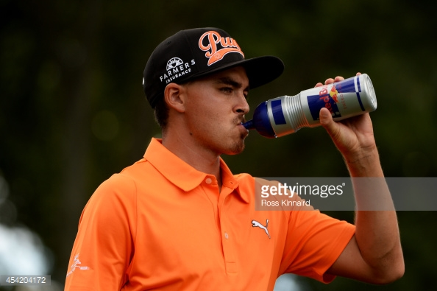
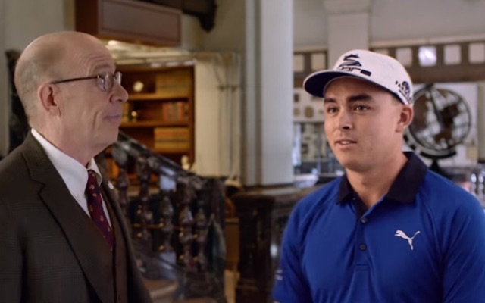
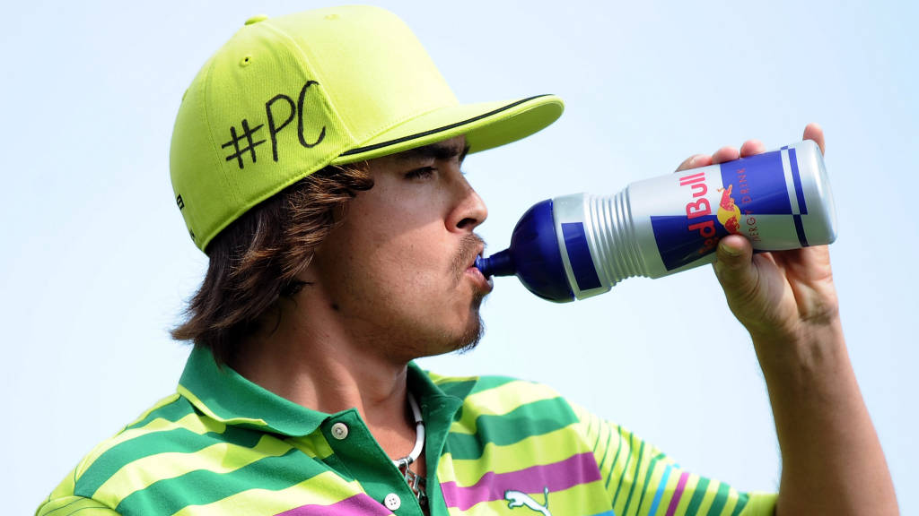
Goals of Sponsorship
Increase Sales
Increase Awareness
Be Competitive
Reach the Target Market
Build Customer Relationships
Develop Image
Notes:
https://www.youtube.com/watch?v=Ed6NMqX6Cf4

Slide 6
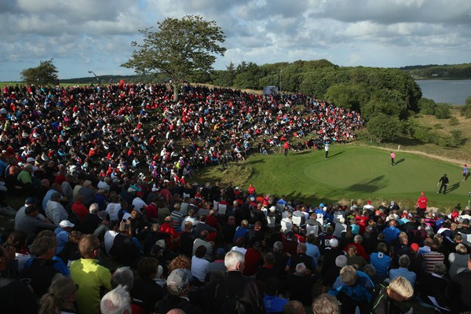
Borrowed Equity!!!
Using the appeal of an event or Sports Property to market a company and/or it’s products
Reason a Company Wants To Be Involved With An Sporting Event or Property

Slide 9
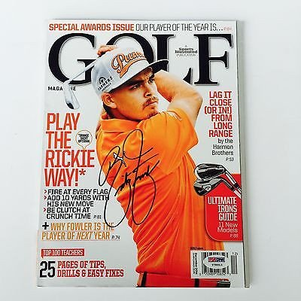
Marketing OF Sports
Applying marketing Principles to the marketing of a “Sports Property”
Sports Properties:
League
Team
Athlete
Stadium
Arena
Program
Competition
Contest
Notes:
10. 11

Slide 10
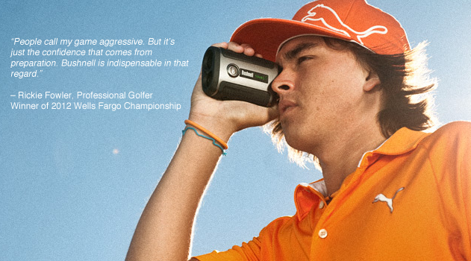
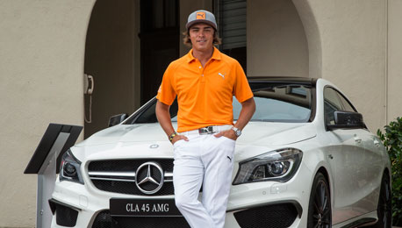
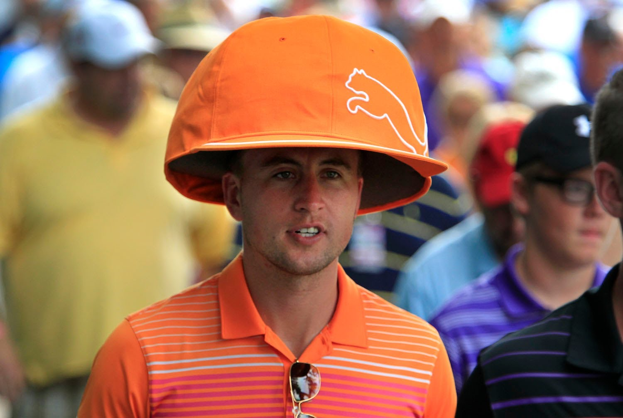
Marketing THROUGH Sports
Marketing of Non-Sports products or services using sports as a media
Notes:
12

Slide 11
Of or Through?

Slide 12
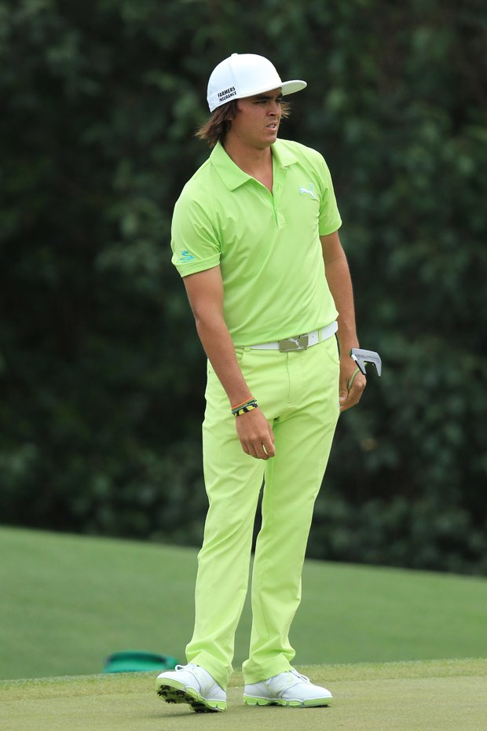
Of or Through?

Slide 13
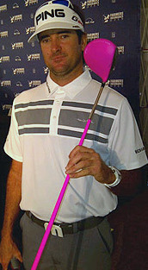
Marketing Products with S&E
Endorsements
Autograph Signing
Promotional Tie Ins
Merchandise
Fan Gear
Worst Endorsements of all time.
BUBBA
Notes:
http://www.businessinsider.com/the-13-worst-celebrity-endorsement-fails-2012-1?op=1
http://www.linkdex.com/en-us/inked/worst-celebrity-spokesperson/ - Best one.

Slide 14
Marketing Products
Autographs
Merchandise

Slide 15
Marketing Products
Promotional Tie In
Fan Gear

Slide 16
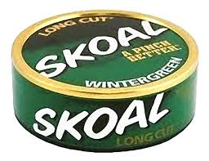
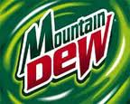
Match-Up Hypothesis
The idea that the sponsor should match up with the appropriate Target Market of the Sports Property

Slide 17
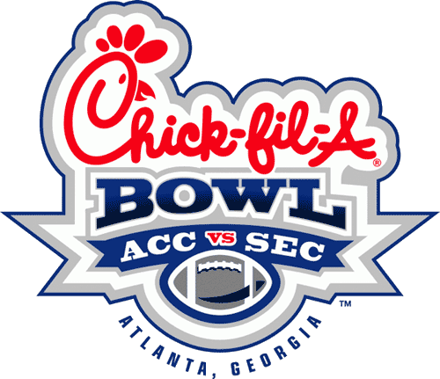
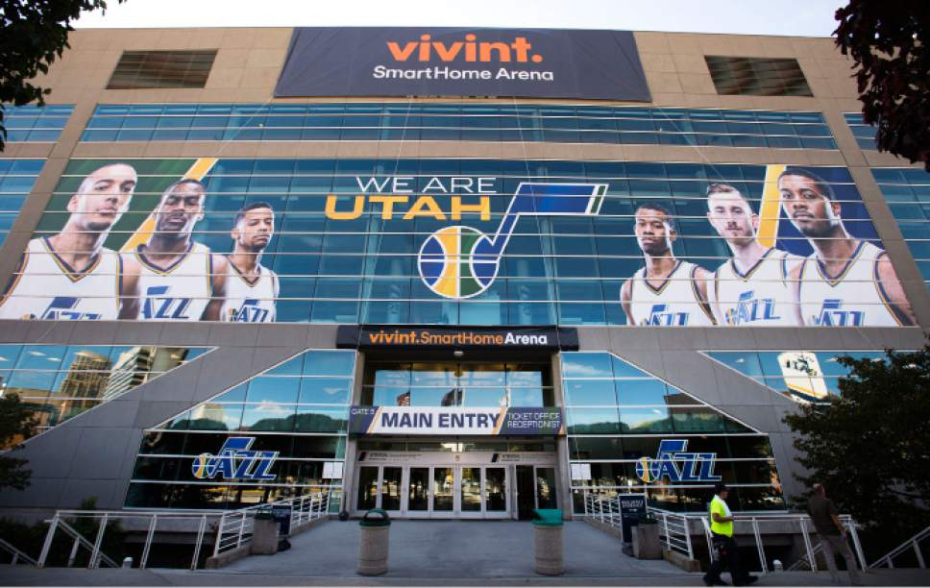
Signature Sponsor
The main sponsor of an event or arena Pays for the Naming Rights of event
Sometimes called a “Title Sponsor”

Slide 18
Sponsorship Exclusivity
Exclusivity in Sponsorship is in “Categories”
Example: Fast Food, Non-Alcoholic Beverages, Banking
Events
Want Narrow Categories for Exclusivity
Sponsors
Want Broad Categories for Exclusivity
“THE OFFICIAL FAST FOOD OF OUR TEAM”
Notes:
https://www.stance.com/nba

Slide 19
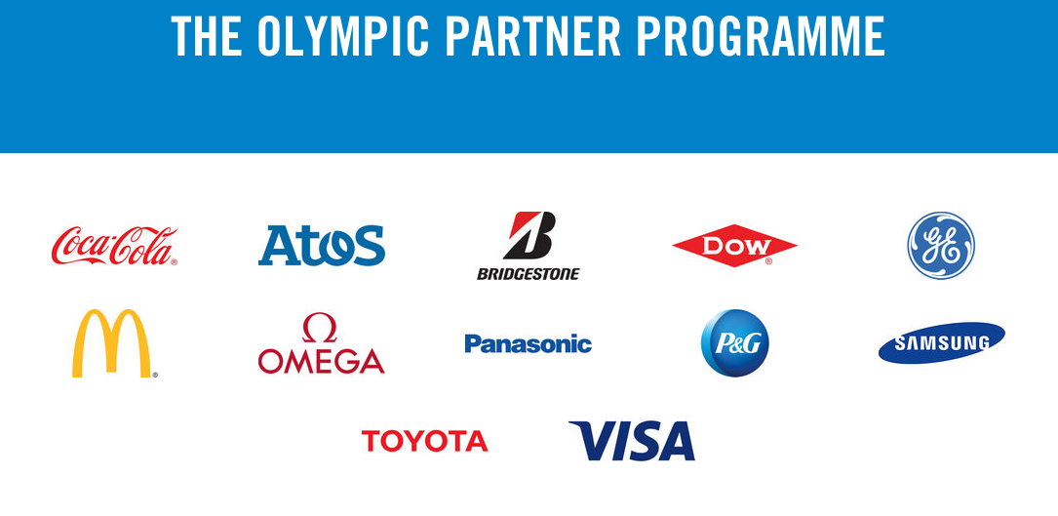
More Exclusivity
Notes:
http://www.sportsbusinessdaily.com/Daily/Issues/2015/09/23/Marketing-and-Sponsorship/NFL-sponsors.aspx
https://www.stance.com/mlb
https://www.stance.com/nba

