Slide 1
There are approximately 4,200 domain names registered every hour or 37 Million of them per year

Slide 2
Facebook has 1.2 Billion Active users There are 7 Billion people on earth so 14% of the worlds population are on Facebook.

Slide 3
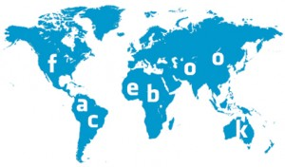
What’s even more crazy is that there are 2.4 Billion Internet users in the world, so 50% of the Internet users are on Facebook

Slide 4
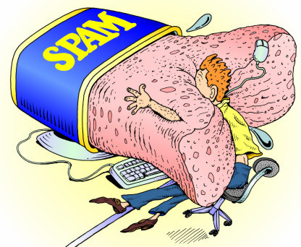
About 250 Billion e-mails are sent each day. 80% or 200 Billion of them are believed to be Spam

Slide 5
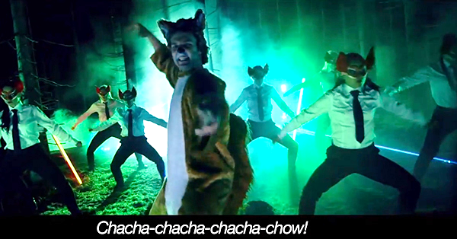
72 Hours of video is uploaded to YouTube every minute, & YouTube does 100 years of copyright checking every day

Slide 6
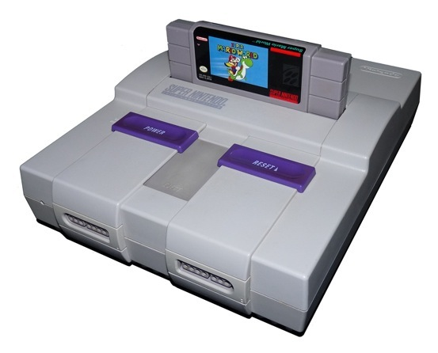
The iPhone 4 is about 2000 times faster than the Super Nintendo

Slide 7
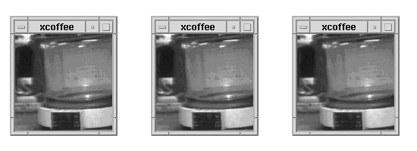
The first ever webcam was used at Cambridge University to watch a pot of coffee

Slide 8
The first ever website is still on the Internet. Click on the picture to see what it looks like

