Slide 1
DIGITAL BUSINESS APPLICATIONS
Understanding Ethics

Slide 2
Digital Business Applications
Standard Two - Students will understand ethical and legal issues pertaining to business.
Objective One - Review and evaluate the fair use policies and acceptable use policies

Slide 3
Essential Questions
Evaluate components of acceptable use policies
Demonstrate ability to follow fair and acceptable use policies on assignments and projects
Discuss ethics in the workplace

Slide 4
FERPA
Federal Information Rights and Privacy Act (FERPA) – Allows parents access to their child's education records, until a student reaches 18 years of age.

Slide 5
Ergonomics
Study of workplace design
For comfort, efficiency, safety, and productivity
http://www.youtube.com/watch?v=KC6nYJ0F6tU&safe=active

Slide 6
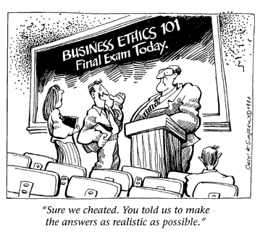
Ethics
What is Ethics?
“Ethics is what’s spearheading our growth, It creates an element of trust, familiarity, and predictability in the business.”
Charlie Wilson, Owner of Houston-Based Salvage company. Worth 1.6 Billion.

Slide 7
Code of Ethics
A code of ethics is a document that outlines the principles of conduct to be used in making decisions with the organization.

Slide 8
Ethics
Ethics are defined as the rules or standards governing the conduct of a person or the members of a profession.

Slide 9
Ethics
A great deal of people think that the ethics used in business are different from those used in everyday life. They often use one code at work, and another at home, justifying their actions in the name of getting the sale, landing the deal, making the numbers, keeping a job. But when it comes down to it, ethics are ethics are ethics.

Slide 10
Some Of the Areas Ethics Cover
Honesty
Security
Adherence to the law
Product safety and quality
Health and safety in the workplace
Conflicts of interest
Employment practices
Selling and marketing practices

Slide 11
Acceptable Use Policies
Components of acceptable use policies:
a code of ethical conduct governing behavior on the Internet
a description of what constitutes acceptable and unacceptable use of the Internet
a description of the consequences of violating the AUP
a statement reminding users that Internet access and the use of computer networks is a privilege, not a right

Slide 12
ASSIGNMENT
District’s AUP: Use the following link to open Alpine School District’s Acceptable Use Policy
http://policy.alpinedistrict.org/policy/5225
Copy and paste the content into a new document. As you read the AUP, highlight items pertaining to key points such as copyright issues, privacy terms, use guidelines, etc. Print this page and staple it to your worksheet.

