Slide 1
E-mail
Electronic Mail

Slide 2
Gmail Accounts
www.gmail.com
Password
Same password as you use to log in to your computer
USERNAME
Skyward Login
@alpinesd.org

Slide 3
Info about E-mail
The first e-mails required both the sender and the receiver to be on-line at the same time
Messages are sent and received through an internet server

Slide 4
Parts of e-mail
Header
To:
Cc:
Bcc:
Subject Line
Body
Message
Can Include Signature
Attachments
Files that are sent with e-mails

Slide 5
Ways to Respond
Reply
Reply To All
Forward

Slide 6
Netiquette A set of social on-line rules
Spell Check
DO NOT USE ALL CAPS (THIS IS YELLING)
Always fill in the subject line
Be care with emoticons and abbreviations
Type what you mean. It is hard to read sarcasm in an e-mail. A good rule is to treat every post or e-mail as if you were sending a copy to your boss, your bishop and your worst enemy

Slide 7
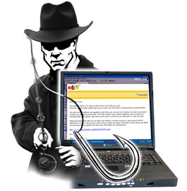
Be Careful Out There
Spam
Unsolicited bulk messages (Like Junk mail on the internet)
Phishing
attempting to acquire information such as usernames, passwords and credit card details (and sometimes, indirectly, money) by masquerading as a trustworthy entity in an electronic communication
Cyberbullying
Use of technology aimed to hurt someone

Slide 8
Passwords
The most hacked passwords in 2013 were:
password
123456
12345678
The best and most secure passwords include:
At least 8 characters long
Upper Case
Lower Case
Number
Special Character (!@#$%^&*<>?)
Qwerty
Abc123
123456789

