Slide 1
Computer Hardware
The physical parts of the computer
Click Here to Continue

Slide 2
How it works
You will only be allowed to click on the yellow arrows at the bottom of the page. They will appear after you’ve read and studied all of the information on the page.
Read all of the information and follow the directions of each slide.
There will be a short quiz at the end.
Begin

Slide 3
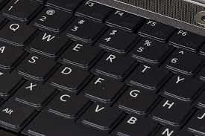
Hardware
Definition: The physical parts of the computer----the stuff that you can touch.
Examples:
Keyboard
Mouse
Monitor
RAM
Hard Drive
Next

Slide 4
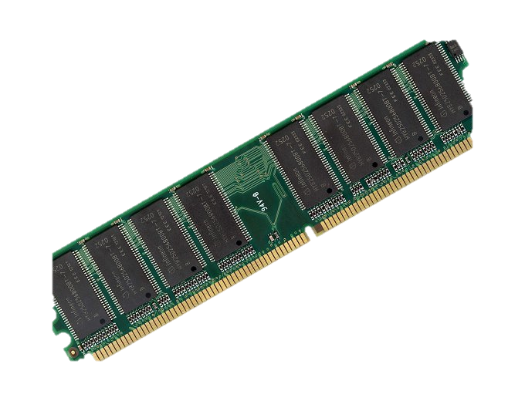
RAM
Random Access Memory
Looses all of its data when the computer is turned off
Next

Slide 5
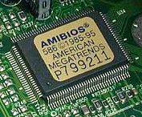
ROM
Read Only Memory
Where your Start up Files are located
Next

Slide 6
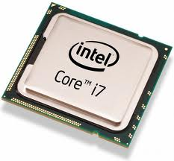
CPU
Central Processing Unit
All of the computers processing goes through this part.
Next

Slide 7
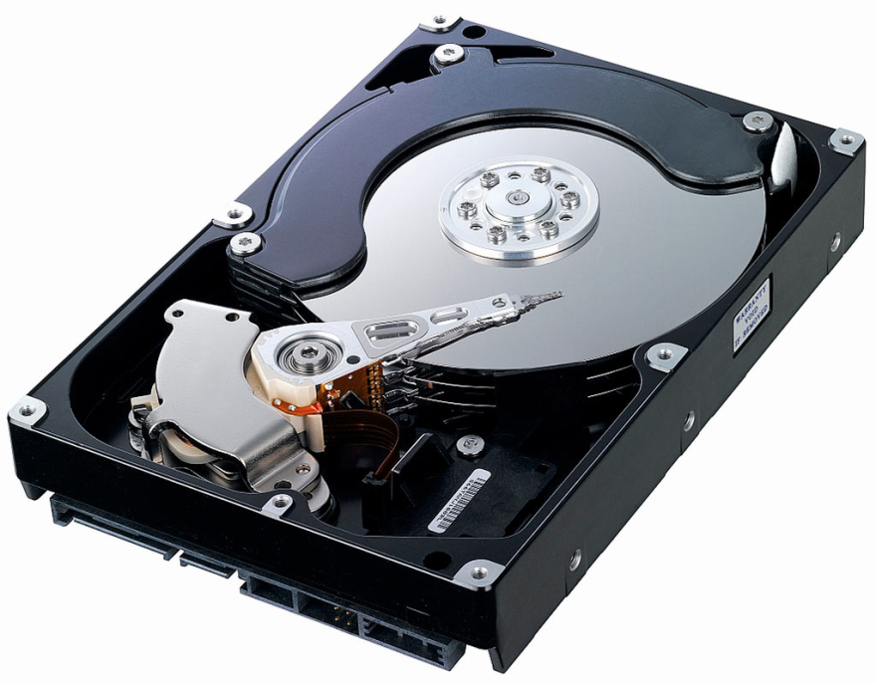
Hard Drive
Main Storage of a computer
Next

Slide 8
Quick Review
What is the Main Storage Area of a Computer?
A
CPU
B
Hard Drive
C
RAM
D
ROM

Slide 9
Correct! The Main Storage Area on a computer is the Hard Drive
Next Question

Slide 10
Sorry, the main storage area on the computer is your Hard Drive.
Next Question

Slide 11
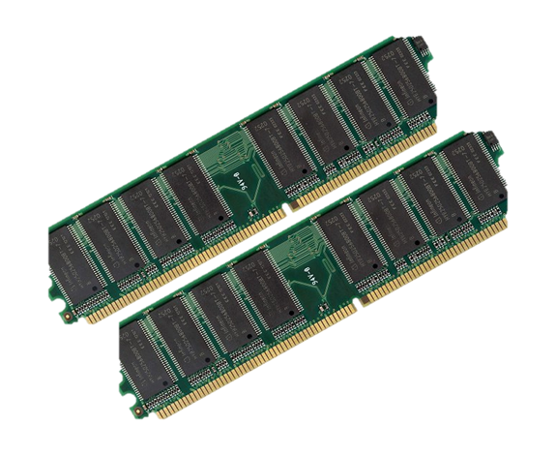
Quick Review
What loses data every time the computer is turned off?
A
CPU
B
Hard Drive
C
RAM
D
ROM

Slide 12
Correct! The RAM looses it’s data every time the computer is turned off
Next Question

Slide 13
Sorry, the RAM looses all of its data when the computer is turned off.
Next Question

Slide 14
Quick Review
Where does all of the computers processing go through?
A
CPU
B
Hard Drive
C
RAM
D
ROM

Slide 15
Correct! All of the computer’s processing goes through the CPU
Next Question

Slide 16
Sorry, the CPU is the device in which all the computers processing goes through.
Next Question

Slide 17
Quick Review
Where are all of the computers start up files located?
A
CPU
B
Hard Drive
C
RAM
D
ROM

Slide 18
Correct! The ROM is where all of the Start up Files are located.
Next Question

Slide 19
Sorry, the ROM is where all of the start up files are located.
Next Question

Slide 20
Quick Review
What is hardware?
A
Computer Programs
B
Physical Parts of the Computer
C
The Computer
D
The inside of the computer

Slide 21
Correct! The Hardware is the Physical Parts of the Computer—the things that you can touch.
Next Question

Slide 22
Sorry, Hardware is the physical parts of the computer. Both inside and outside, the things that you can touch.
Next Question

Slide 23
Good Job. Please press ESC on your Keyboard and wait for Mr. Assmus’ instructions

